Slide 1
ISO Developer’s Toolkit - mdTranslator in Rails 2015 CDI Workshop
May 11, 2015
Stan Smith, USGS

Slide 2
From the command line, navigate to the directory to hold your new Rails application. This will become the parent directory of the new Rails application.
Generate the new rails application. Type: > rails new translator
A new directory named ‘translator’ will be created to hold the Rails application.
Test the new ‘translator’ rails application.
Change directory to the Rails application just created > cd translator
Start the Rails server. Type: > rails server
From a browser type http://localhost:3000
You should see the ‘Welcome aboard’ page.

Slide 3
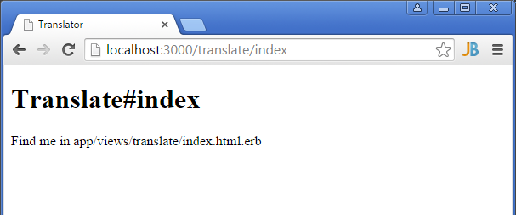
Generate a home page using Rails helpers. Type: > rails generate controller translate index
Test the new index page that Rails generated… http://localhost/translate/index

Slide 4
Set the index page as the default page for this website. In the ../config/routes.rb file add a line to set the root to ‘translate#index’.
Rails.application.routes.draw do get 'translate/index' root 'translate#index'

Slide 5
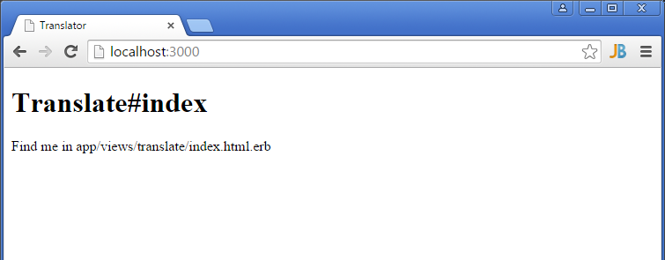
Now the index page will show at root.

Slide 6
Add a simple HTML form into the app/views/translate/index.html.erb file replacing all the Rails generated code.

Slide 7
<!-- # Alaska Data Integration working group - ADIwg # REST endpoint controller for demonstration of mdTranslator --> <h2> mdTranslator Rails example</h2> <div id="form_container"> <%= form_tag('/translate') do %> <div> <h3>Submit JSON</h3> <p> Paste or type JSON, choose options, and click Submit. Valid ISO 19115-2 XML should be generated. <br> </p> <div> <textarea name="file">Place mdJson here</textarea> </div> </div> <div class="buttons"> <input type="hidden" name="form_id" value="759352"/> <input id="saveForm" class="button_text" type="submit" name="submit" value="Submit"/> </div> <div> <p> For more info visit the <a href="http://www.adiwg.org/mdTranslator">mdTranslator website</a>. </p> </div> <% end %> </div>

Slide 8
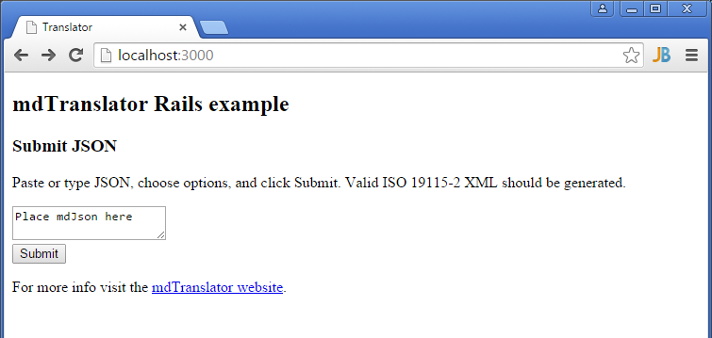
The updated index looks like …

Slide 9
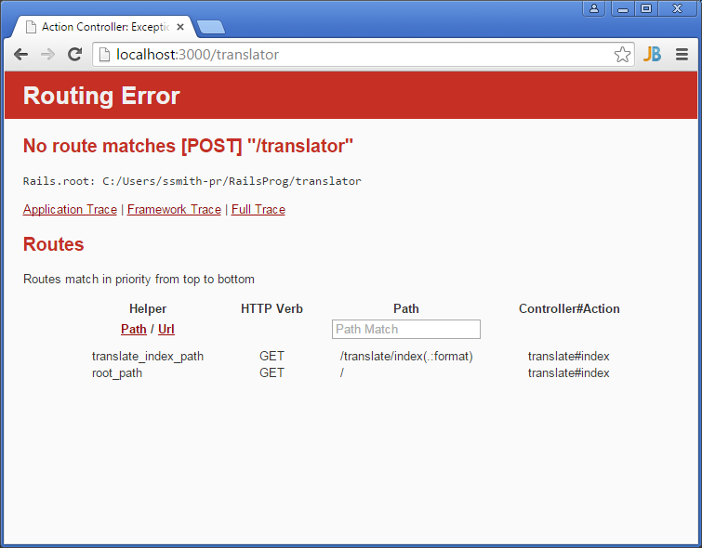
Click ‘Submit’ and Rails shows a ‘Routing Error’. We have not handled the HTTP POST in our routing or controller.

Slide 10
Rails only generated code in the router and controller to process the HTTP GET verb. Add ‘resources’ to ../config/routes.rb to have Rails automatically handle all HTTP verbs, including POST.
Rails.application.routes.draw do get 'translate/index' root 'translate#index' resources :translate

Slide 11
Add code in the ../app/controllers/translate_controller.rb to intercept and process the HTTP POST request.
class TranslateController < ApplicationController # process GETs def index end # process POSTs def create render inline: '<h2>This is the HTTP POST</h2>' end end

Slide 12
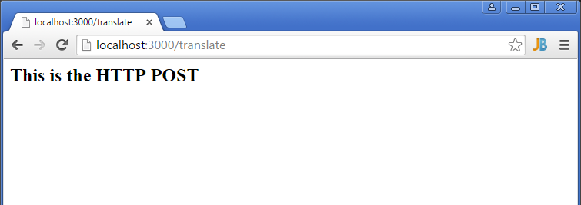
Now the HTTP POST is properly intercepted when the ‘Submit’ button is pressed.

Slide 13
With the basic structure of the website is complete connect the mdTranslator gem to the website. Add a gem request to the ../Gemfile …
Update the website’s gems. From the command line type: >bundle update. The adiwg-mdtranslator gem and all its dependencies will be loaded to your Rails website.
Remember, you must restart the Rails server after adding new gems.
# Alaska Data Integration working group metadata translator gem 'adiwg-mdtranslator', '~> 1.0'

Slide 14
Now we need to write a simple script to process the HTTP POST. Return to the ../app/controllers/translate_controller.rb and replace the ‘render inline:’ statement we placed to test the connection and routing with something like this…
# process POSTs def create # load file and parameter from POST fileObj = params[:file] # call the ADIwg metadata translator @mdReturn = ADIWG::Mdtranslator.translate( file: fileObj, reader: 'mdJson', validate: 'normal', writer: 'iso19115_2', showAllTags: false) render xml: @mdReturn[:writerOutput] end

Slide 15
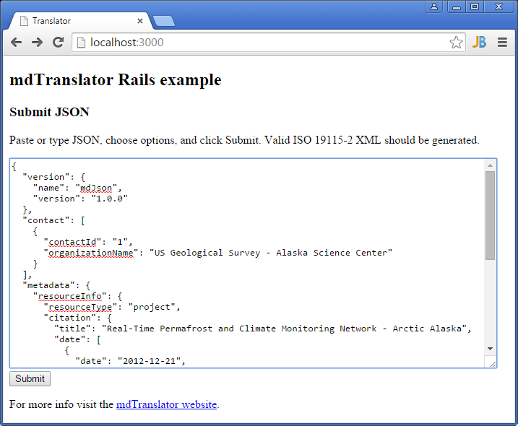
After the server restarts, navigate to the website root and enter some valid mdJson.

Slide 16
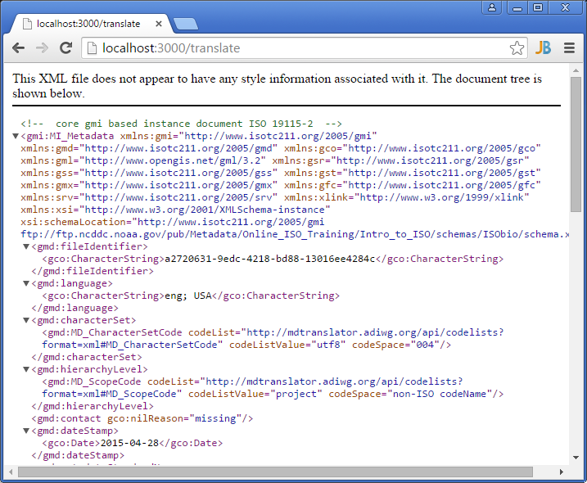
Click submit and you should see ISO 19115_2 returned from you locally hosted web service.

Slide 17
This ‘non-award winning’ website only demonstrates the simplicity of building a website that can interface with the ADIWG ISO Metadata Toolkit. A real website would need to be more robust checking for errors, handling all mdTranslator options, and handling all response types returned from the mdTranslator (XML. JSON, JSONp, text, plain). But it’s a start.

Slide 18
Questions?
Discussion?

